Slide 1
1Mg Mall Customer Base Analysis
Submitted by:
Debaditya Mukhopadhyay
dmdebaditya02@gmail.com

Slide 2
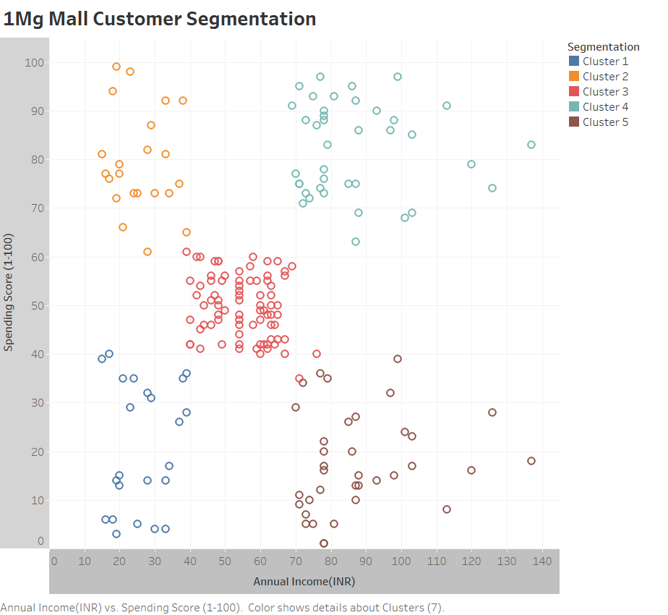
Cluster Plot:

Slide 3
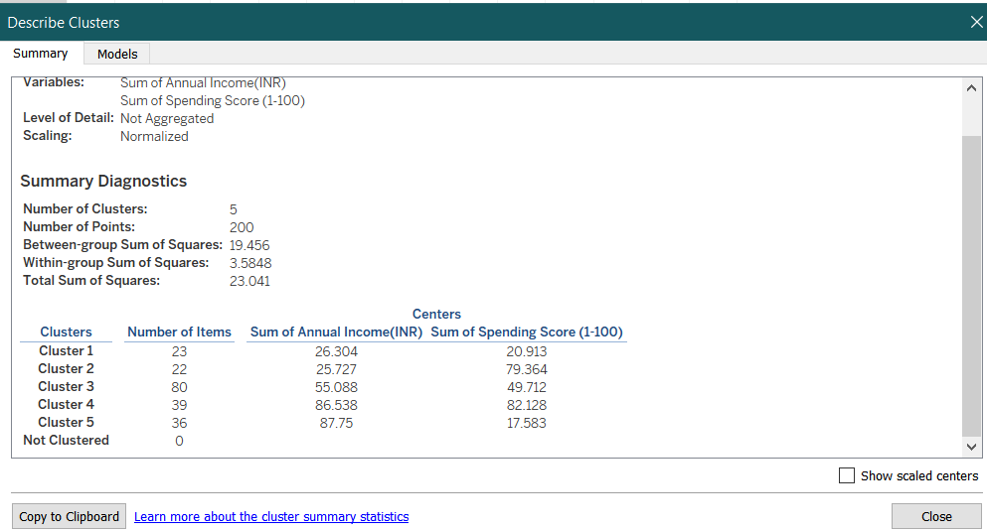
Cluster Details:
Understanding/ Assumptions for the cluster:
Focus is on customers, based on their annual income and spending ability irrespective of their gender and age.
Assumption have been made that annual income does not directly impact spending ability and people with low income can have more spending score and vice versa.
Gender biasing is not a suitable since both gender have similar trend in income and spending.
Age as a factor produces huge variation and people of average age having high income compared to people of seniority. But using age as a parameter to find the best suitable target customers was seen to varry at a great extent.
The most accurate cluster was plot when Annual Income and Spending score was considered as parameters and it provided an accurate overview of the best suitable customer base to attract and target for higher revenue genration and more footfall in the mall.

Slide 4
Q-Matrix:
Low Income
High Spending score
High Income
High Spending score
Consider Targeting
High Priority
Must Target
Cluster 2
Cluster 4
Quadrant 4
Quadrant 1
Low Spending score
Variable Income
Moderate Income
Moderate Spending score
Least Priority
Cluster 3
Target but Difficult to Market
Cluster 1
Cluster 5
Quadrant 3
Quadrant 2

Slide 5
DECISION TABLE:
CLUSTER | QUADRANTS | REASON BEHIND DECISION
Cluster 4 | 1 | Assemblage of customers with high annual income and high spending score, there by marketing to them for luxury items will generate better revenue for any business since they have the spending ability. It also has the second highest customer base.
Cluster 3 | 2 | High density customers with medium(average) annual income and average spending score. Due to diversity in customer base w.r.t age,gender,choices it will be difficult to focus on particular genre of item. But the quantity of customers is lucrative and an opportunity for any kind of business.
Cluster 2 | 4 | Consists of minimal number of customers with high spending ability but low income and will not generate any fruitfull revenue.
Cluster 1 Cluster 5 | 3 | Comprises of customers with both high annual income and low annual income but their spending score is least among other clusters. They are more like window shoppers and must not be focussed on.

